Slide 1

Bank Performance Analysis
Our Team (Group – 02)
Rithik
Pratiksha
Shalini
Amrutha
Harshal
Abhishek

Slide 2
Project Objective
This is Bank loan of Customers project where we were provided with 2 datasets with .csv extension files having 39k rows each and the objective was to analyze the growth that bank got within given years in loans.
We used MS-Excel, MySQL for analyzing, cleaning and removing duplicates from dataset and prepared dashboard using Tableau and PowerBI tools where we did calculations, merging and prepared interactive dashboards.

Slide 3




Agenda
Introduction & Problem Statement
Business
objective
KPI’S
Dashboard
Problem Statement
Analytical Tools
Year wise loan amount Stats
Grade and sub grade wise revol_bal
Total Payment for Verified Status Vs Total Payment for Non Verified Status
State wise and month wise loan status
Home ownership Vs last payment date stats
Excel
MySQL
PowerBI
Power query
Tableau
PPT for editing and presentations

Slide 4
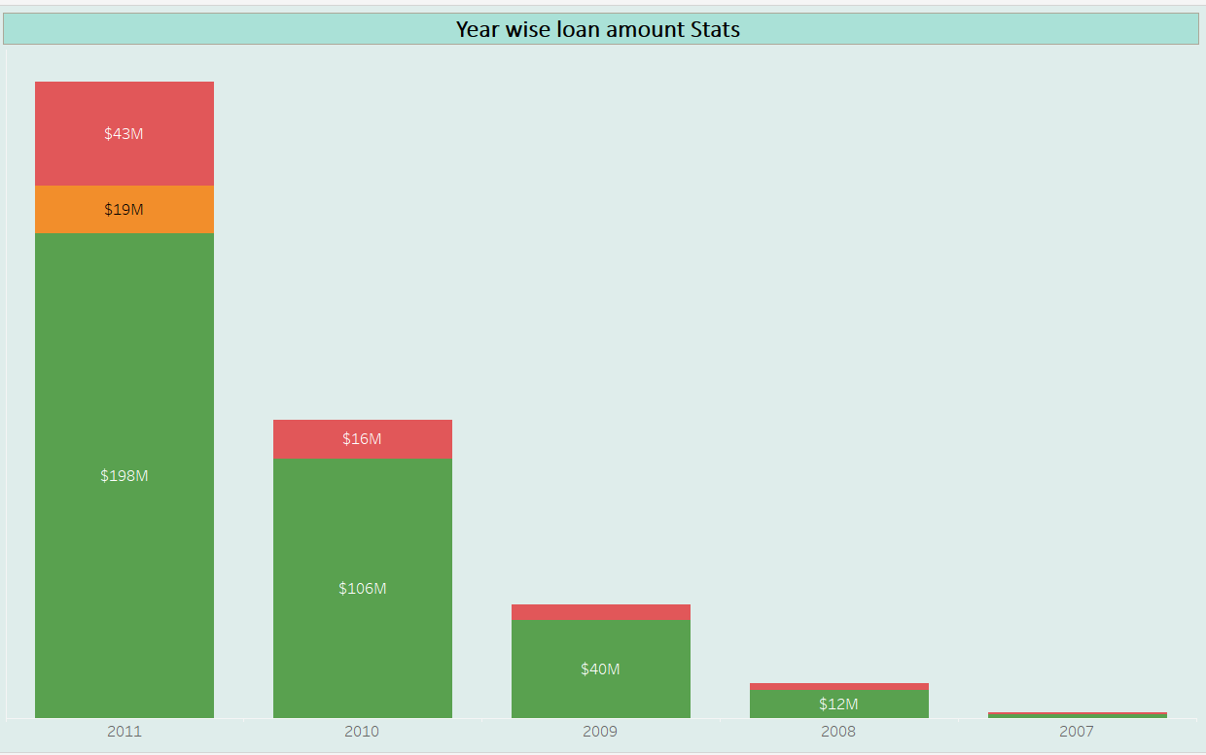
All KPI Analysis & Recommendation
Analysis
As per the Analysis, the highest amount being $261 million in 2011 and the lowest at $2 million in 2007. Each year's loan amount is categorized into charged off, current, and fully paid. For instance, in 2011, $198 million of loans were fully paid, $43 million were charged off, and $19 million were outstanding (current).
From 2007 to 2011 there’s a noticeable increase in total loan amount issued by the year by year with the highest amount observed in 2011.
Percentage increase in loan amounts between consecutive years.
Analysis of Year wise loan amount Stats

Slide 5
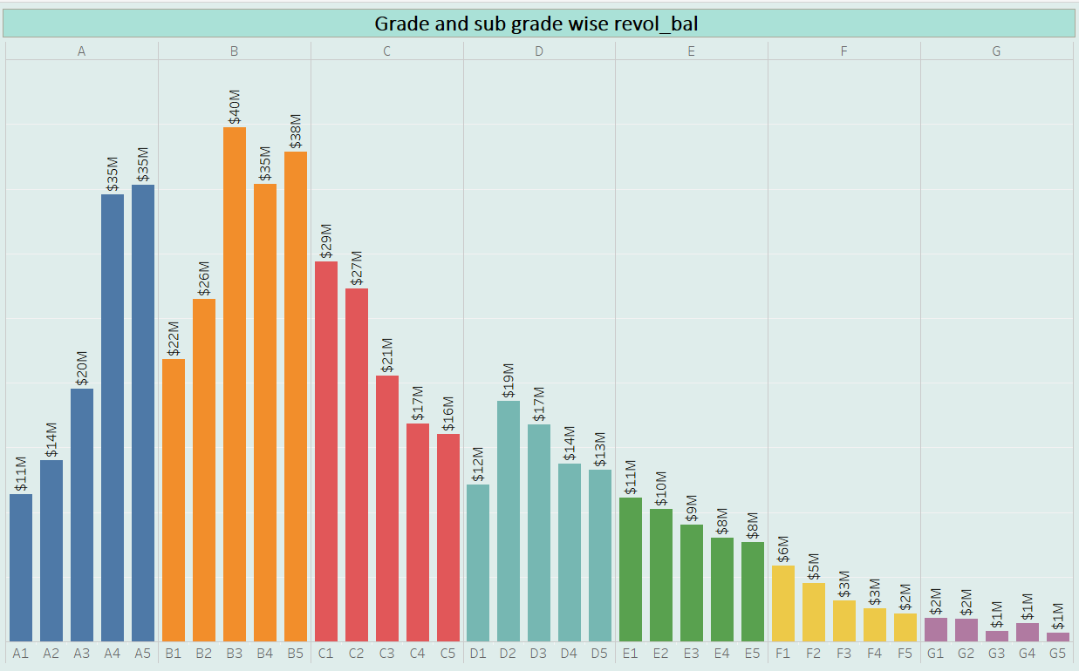
Analysis of Grade and sub grade wise revol_bal
Analysis
The total loan amount for Grade B is $40M, which is highest among all grade.
Overall, the analysis of grade and subgrade wise loan amounts provides an understanding of the distribution of loan amounts across different risk level categories. Higher-grade customers tend to have higher loan amounts, while lower-grade customers have relatively lower loan amount.

Slide 6
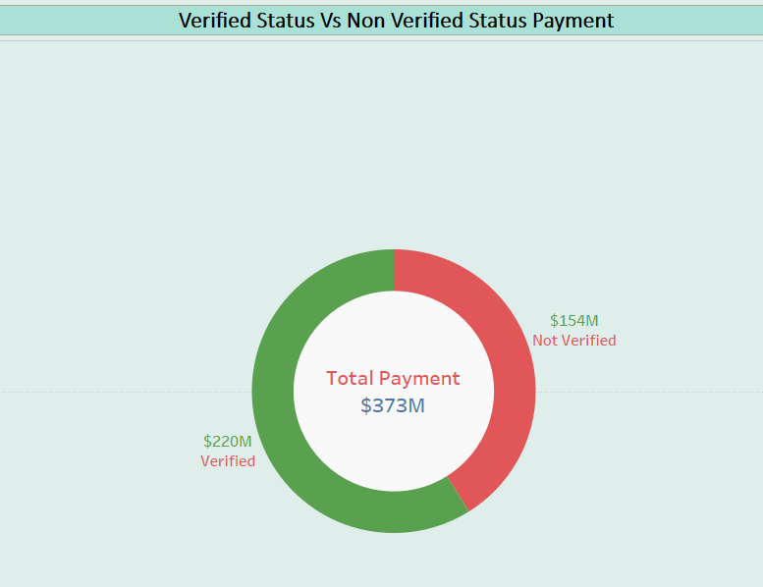
Analysis of Total Payment for Verified Status Vs Total Payment for Non Verified Status
Analysis
This analysis would provide insight into the typical payment behavior of users based on there verification status.
Most of the verification status is verified from the total verification status.

Slide 7
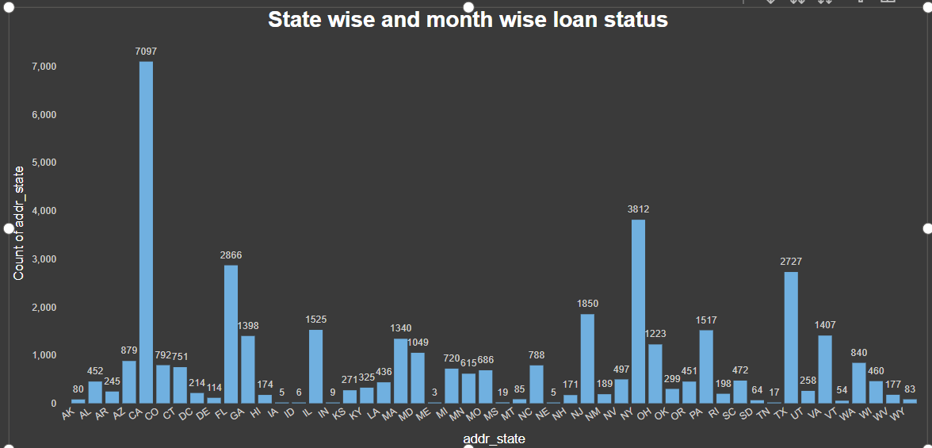
Analysis for State wise and month wise loan status
Analysis
We have understood that California (Ca) has highest numbers of loan (7097), followed by New York (Ny) with 3812 loan Texas (Tx) with 2727 loan. This indicates that these states have a relatively higher demand for loan.
Across all 50 addr_state, Count of addr_state ranged from 3 to 7097.

Slide 8
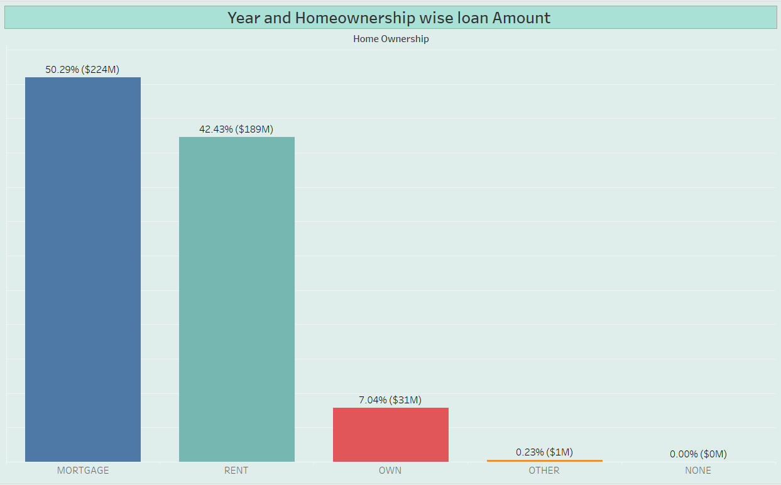
Analysis for Statistical Overview of Home Ownership
Analysis:
As per the Analysis, mortgage has highest loan count 50.29 % ($224M), i.e. significant number of customers who have mortgage on their Properties.
Rent is second most common home ownership status 42.43 % ($189M), indicating a large number of customers who are renting their homes.

Slide 9
What we learn
Importances of Key Performance indicator in data Analytics.
Parameters to be assessed after loan distribution by banks e.g. Home ownership, Revolving balance, grades, verification status, etc.
How all these parameters are extracted from data to make pivot tables, charts and beautify interactive and mesmerizing dashboards in Excel, Power Bi and Tableau using slicers, filters, icons and images. Writing queries for the same in SQL.

Slide 10
Challenges During Project
True challenge was to assemble our classroom knowledge and to put it into this real-world.
Different opinions and priorities to be gathered as a team for each tasks.
Compiling and selecting the best outcomes for presentation.

Slide 11
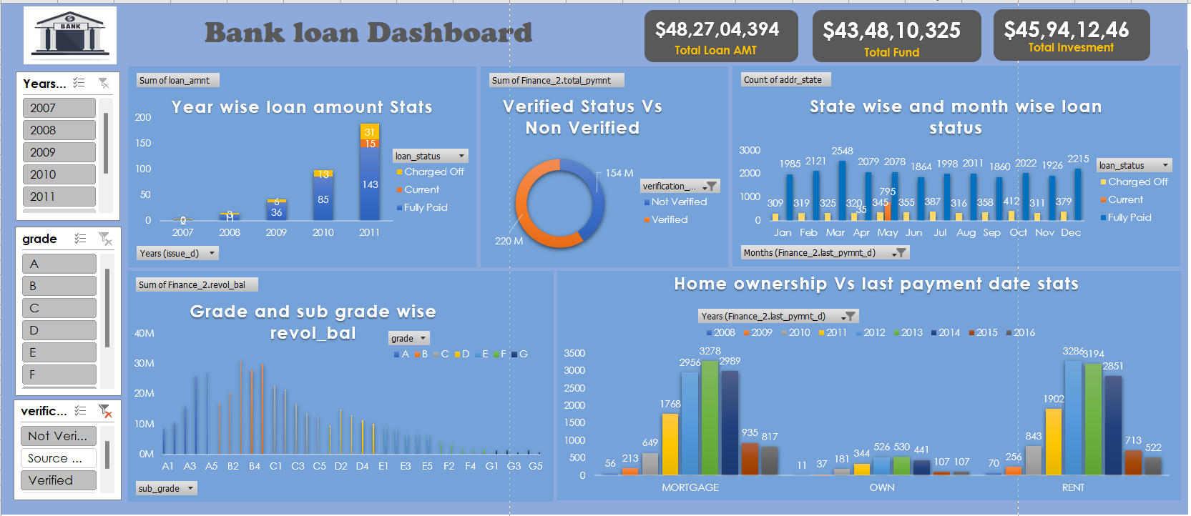
Excel Dashboard

Slide 12
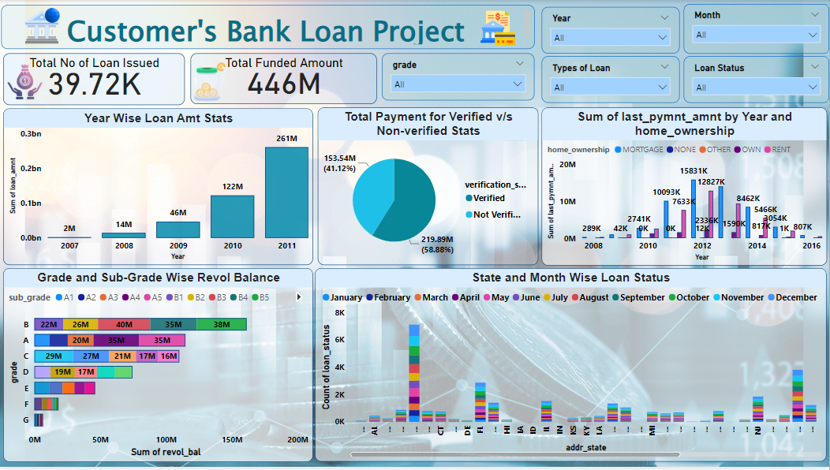
Power BI Dashboard

Slide 13
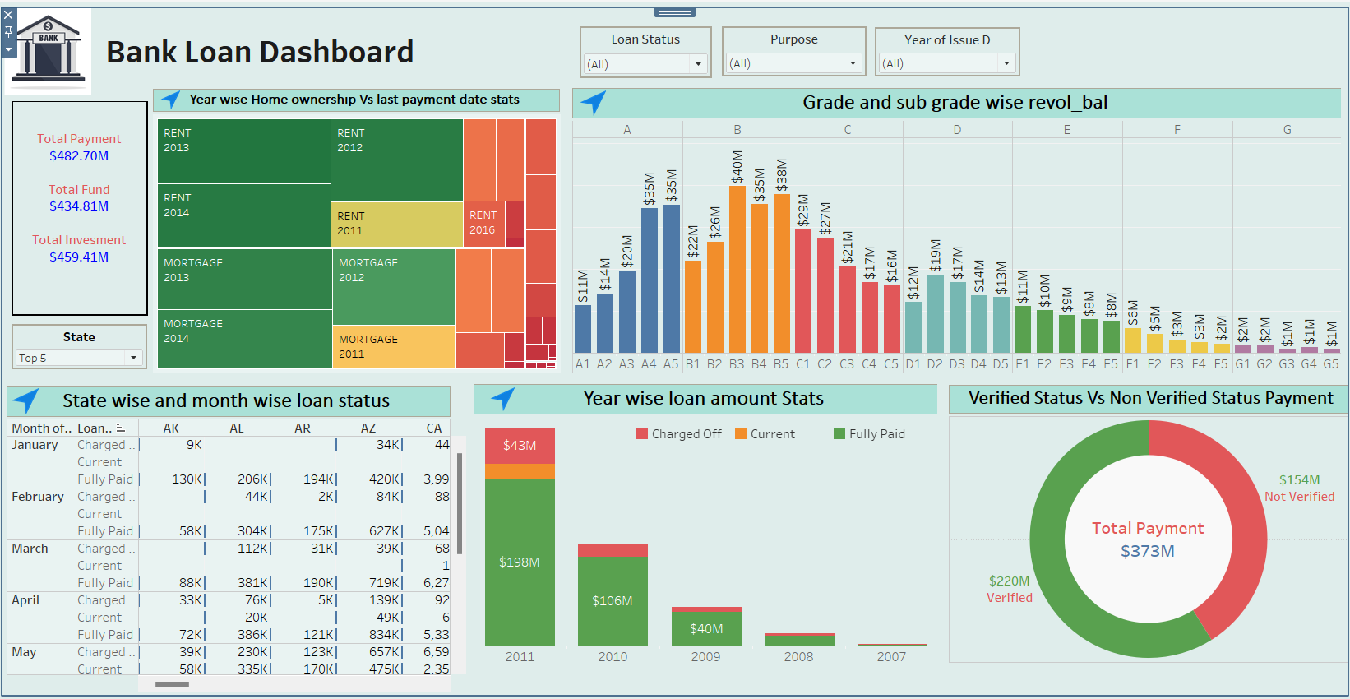
Tableau Dashboard

Slide 14


